Slide 1
Introduction to HDF5
Session Three
HDF5 Software Overview
Copyright © 2010 The HDF Group. All Rights Reserved

Slide 2
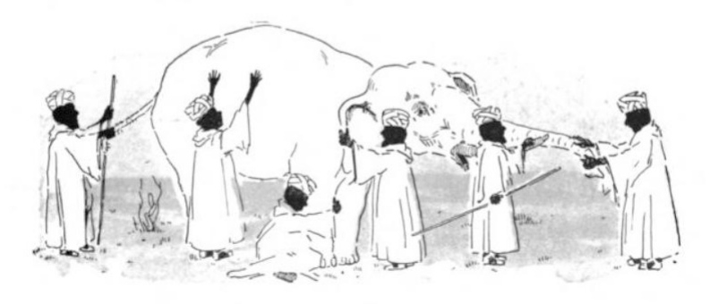

Our Purpose Today
Familiarize you
with HDF5 and its
capabilities.
2) Help you understand
how HDF5 might be
applied to your data
management challenges.
Copyright © 2010 The HDF Group. All Rights Reserved

Slide 3
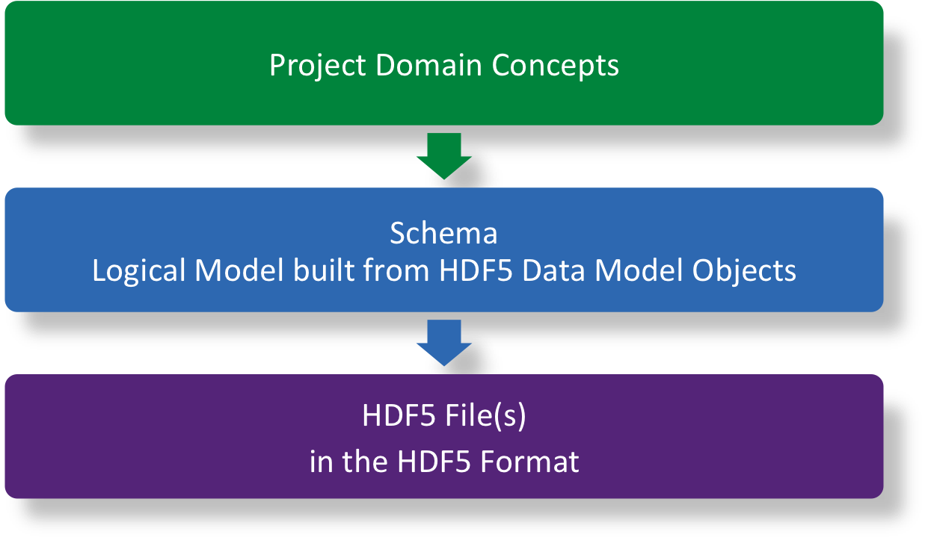
Project Data Model
Copyright © 2010 The HDF Group. All Rights Reserved

Slide 4

HDF5 Technology Platform
HDF5 data model
  The “building blocks” for data organization and specification
HDF5 software
  Library, language interfaces, tools
HDF5 file format
  Bit-level organization of HDF5 file
  Self-describing
  Designed for high-performance
Software:
the missing
link
Copyright © 2010 The HDF Group. All Rights Reserved

Slide 5
HDF5 Software
Fundamentally, HDF5 software operates on:
Objects in the HDF5 Data Model
  Write a logical model to an HDF5 file
  Reconstruct a logical model from an HDF5 file
Raw data values in datasets and attributes
  Write values to an HDF5 file
  Read values from an HDF5 file
Note: Updates, partial writes, and partial reads are supported.
Copyright © 2010 The HDF Group. All Rights Reserved

Slide 6



The Big Picture
mental
model of
data
User Application
HDF5 Software
HDF5 File
Copyright © 2010 The HDF Group. All Rights Reserved

Slide 7
HDF5 Philosophy Review
One software library (from The HDF Group)
  Options to adapt I/O and storage to data needs
  Layers above and below
Work well with other technologies
Attention to compatibility
Copyright © 2010 The HDF Group. All Rights Reserved

Slide 8



Software Layers – Library View
User Application
HDF5 Object APIs (in C)
Schema + Data
HDF5 Object APIs (in C):
Schema + Data + Properties
HDF5 Library Internals:
memory management, conversions, other details…
Virtual File I/O Drivers:
Posix I/O, Split Files, MPI I/O, …
OS, MPI-IO, Filesystem, SAN, ...
File
HDF5 File
File on
Parallel
Filesystem
Split Files
Copyright © 2010 The HDF Group. All Rights Reserved

Slide 9
HDF5 Software (in C)
Library and full set of HDF5 Object APIs written in C
  Portable across platforms (in 1996)
  High-performance
C is not object-oriented, but we have HDF5 Objects
  No classes in C
    Simulated through naming conventions
  No object instances in C
    Simulated through identifiers
      Identifer (handle) returned when object created
      Identifer used to invoke methods on specific instance of object
Copyright © 2010 The HDF Group. All Rights Reserved

Slide 10

HDF5 Object APIs (Schema + Data Values)
HDF5 Objects
Prefix
H5F
H5D
H5T
H5S
H5A
H5G
H5L
For Example…
H5Fcreate
H5Dwrite
H5Tget_order
H5Sclose
H5Aget_space
H5Gopen
H5Literate
File
Dataset
Datatype
Dataspace
Attribute
Group
Link
hid_t file_id, group_id;
file_id = H5Fcreate(“file.h5”, … );
group_id = H5Gcreate(file_id, “January”, … );
Copyright © 2010 The HDF Group. All Rights Reserved

Slide 11

HDF5 Properties
Mechanism for passing information between applications and HDF5 software
  Property information is not directly related to the HDF5 data model objects or data values
  “Knobs” that control the advanced features of HDF5
Copyright © 2010 The HDF Group. All Rights Reserved

Slide 12
HDF5 Properties
Creation Properties
  Set when HDF5 Object is created; persist in HDF5 file
    Size of symbol table B-trees for File
    Storage layout for Dataset
Access Properties
  Set when HDF5 Object is opened; persist until Object closed
    File driver
    Type conversion buffer size
Property Lists exposed by H5P API
Copyright © 2010 The HDF Group. All Rights Reserved

Slide 13
General Programming Paradigm
Properties of object are optionally defined
  Creation properties
  Access properties
  Default values used if none are defined
Object is opened or created
Object is accessed, possibly many times
Object is closed
hid_t plist_id, dset_id;
plist_id = H5Pcreate(H5P_DATASET_CREATE);
status = H5Pset_chunk(plist_id, …);
dset_id = H5Dcreate(group_id,”1”,…,plist_id,H5P_DEFAULT);
Copyright © The HDF Group. All Rights Reserved

Slide 14

Dataset: Library and Format View
HDF5 Datatype
Integer 32bit LE
HDF5 Dataspace
Rank
Dimensions
3
Dim_0 = 4
Dim_1 = 5
Dim_2 = 7
Attributes
Storage Info
Time = 32.4
Chunked
Pressure = 987
Temp = 56
Copyright © 2010 The HDF Group. All Rights Reserved

Slide 15



Software Layers – Languages View
User Application
HDF Java Object Package
Fortran 90
C++
Java HDF5 Interface (JHI5)
MATLAB™
h5py
HDF5 Object APIs (in C)
HDF5 Library Internals
Virtual File I/O Drivers
File
Copyright © 2010 The HDF Group. All Rights Reserved

Slide 16
Software Layers – Tools View
HDFView
HDF Java Object Package
h5dump
h5ls
h5repack
…
Java HDF5 Interface (JHI5)
HDF5 Object APIs (in C)
HDF5 Library Internals
Virtual File I/O Drivers
File
Copyright © 2010 The HDF Group. All Rights Reserved

Slide 17
Portability & Robustness
Runs on many platforms*
  Linux and UNIX workstations
  Windows, Mac OS X
  Crays, VMS systems
  Large distributed-memory clusters
Quality Assurance
  Daily regression tests on key platforms
  Meets NASA’s highest technology readiness level
  *platform = architecture + OS + compiler
Copyright © 2010 The HDF Group. All Rights Reserved

Slide 18
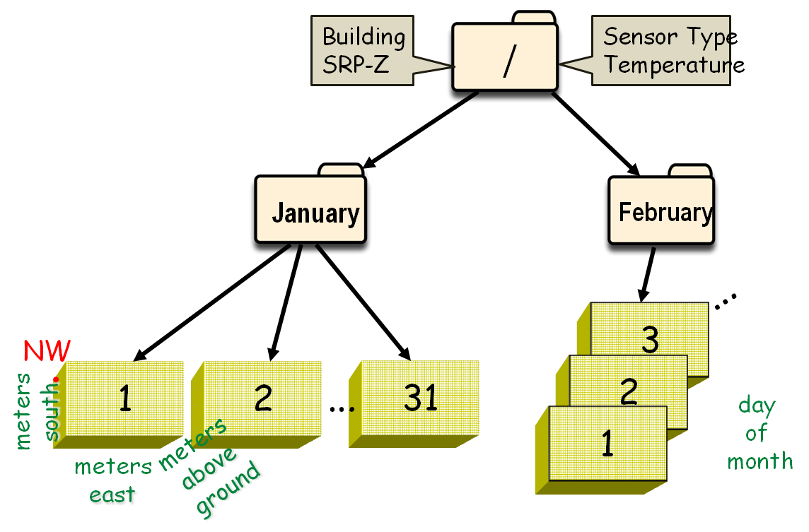
Software Layers – Project Domain View
sensor reading
location
date
building
Building Temperature Monitoring Application
saveReading(building, location, value, date)
getAverageReading(building , start_date, end_date)
…
Building Sensor APIs
Building Temperature Monitoring Application
HDF5 Software
HDF5 File
Copyright © 2010 The HDF Group. All Rights Reserved

Slide 19

Software Layers – CFD Domain View
boundary conditions
flow equations
geometry definition
turbulence …
My Computational Fluid Dynamics Application
Your CFD Application
  CGNS: CFD General Notation System
  http://www.grc.nasa.gov/WWW/cgns/index.html
HDF5 Software
HDF5 File
Copyright © 2010 The HDF Group. All Rights Reserved

Slide 20


Software Layers – Voxel Domain View
voxels,
fluid simulation,
volume rendering,
movies
Alice in Wonderland
imageworks.com
  Field3D: an open source library for storing voxel data developed by Sony Pictures Imageworks to replace three different in-house file formats.
  http://opensource.imageworks.com/?p=field3d
HDF5 Software
HDF5 File
Copyright © 2010 The HDF Group. All Rights Reserved

Slide 21

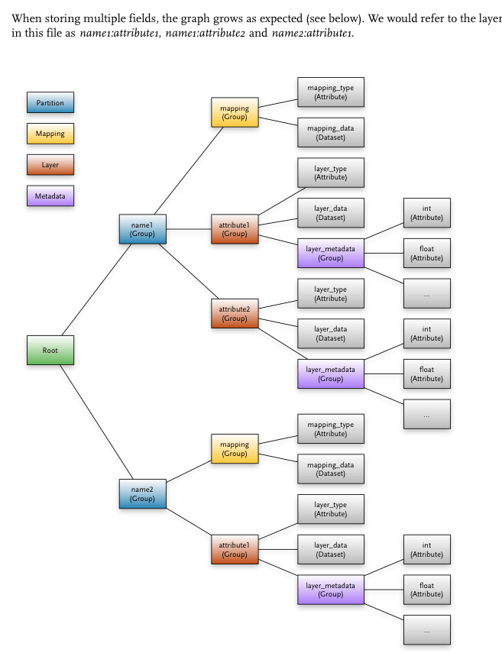
Field3D Programmers Guide
Copyright © 2010 The HDF Group. All Rights Reserved

Slide 22
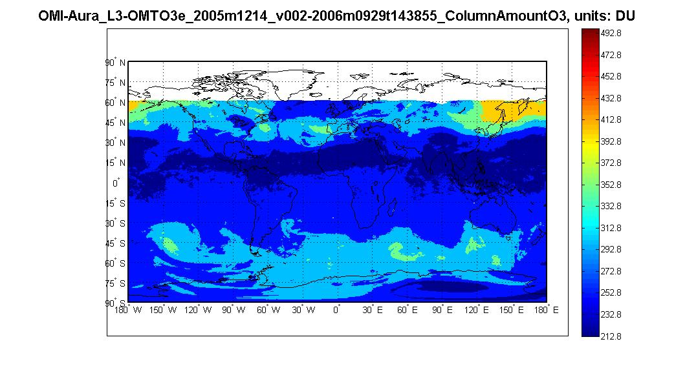
Software Layers – EOS Domain View
Grids
Swaths
Points
UVReflectivity
Instrument Name
NASA Data Product Application
Climage Modeling Application
  NASA HDF-EOS5 APIs
  http://hdfeos.org
MATLAB™
HDF5 Software
HDF5 File
OMI-Aura_L3-OMTO3e_2005m1214_v002-2006m0929t143855.he5
Copyright © 2010 The HDF Group. All Rights Reserved

Slide 23
h5ls
> h5ls –r –f
/ Group
/HDFEOS Group
/HDFEOS/ADDITIONAL Group
/HDFEOS/ADDITIONAL/FILE_ATTRIBUTES Group
/HDFEOS/GRIDS Group
/HDFEOS/GRIDS/OMI\ Column\ Amount\ O3 Group
/HDFEOS/GRIDS/OMI\ Column\ Amount\ O3/Data\ Fields Group
/HDFEOS/GRIDS/OMI\ Column\ Amount\ O3/Data\ Fields/ColumnAmountO3 Dataset {720,1440}
/HDFEOS/GRIDS/OMI\ Column\ Amount\ O3/Data\ Fields/Reflectivity331 Dataset {720,1440}
/HDFEOS/GRIDS/OMI\ Column\ Amount\ O3/Data\ Fields/UVAerosolIndex Dataset {720,1440}
/HDFEOS\ INFORMATION Group
/HDFEOS\ INFORMATION/StructMetadata.0 Dataset {SCALAR}
>
Copyright © 2010 The HDF Group. All Rights Reserved

Slide 24
h5dump
> h5dump -H
HDF5 "OMI-Aura_L3-OMTO3e_2005m1214_v002-2006m0929t143855.he5" {
GROUP "/" {
GROUP "HDFEOS" {
GROUP "ADDITIONAL" {
GROUP "FILE_ATTRIBUTES" {
ATTRIBUTE "EndUTC" {
DATATYPE H5T_STRING {
...
GROUP "Data Fields" {
DATASET "ColumnAmountO3" {
DATATYPE H5T_IEEE_F32LE
DATASPACE SIMPLE { ( 720, 1440 ) / ( 720, 1440 ) }
ATTRIBUTE "MissingValue" {
DATATYPE H5T_IEEE_F32LE
DATASPACE SIMPLE { ( 1 ) / ( 1 ) }
}
...
Copyright © 2010 The HDF Group. All Rights Reserved

Slide 25
Review
HDF5 consists of
  file format
    self-describing, structures to support high-performance
  software
    layers for compatibility and extensibility
    performance features
  data model
    file, dataset, datatype, dataspace, attribute, group, link
HDF5 designed to support
  management of high-volume, complex data
  data sharing and preservation
Copyright © 2010 The HDF Group. All Rights Reserved

Slide 26

Stretch Break
… while I start HDFView demo
with AURA file
Copyright © 2010 The HDF Group. All Rights Reserved

